Slide 1
EV Data analysis

Slide 2
Introduction
As the world increasingly shifts towards sustainable transportation solutions, electric vehicles (EVs) have emerged as a pivotal component in reducing carbon emissions and promoting energy efficiency. The analysis of EV data is essential for understanding market trends, consumer behavior, and the overall impact of electric vehicles on the environment and economy.
This EV Data Analysis focuses on various dimensions of the electric vehicle market, including sales figures, vehicle types, charging infrastructure, and regional adoption rates. By examining these factors, we can gain insights into the growth trajectory of the EV market, identify challenges and opportunities, and inform stakeholders such as manufacturers, policymakers, and consumers.

Slide 3
TABLE OF CONTENTS
01
02
03
04
EV Powertrain Sales in the world
EV Chargers Spread in the world
EV types Sales in the world
05
Electricity demand in the world
EV World Market

Slide 4
01
EV Powertrain Sales in the world

Slide 5
EV Powertrain Sales in each region

Slide 6
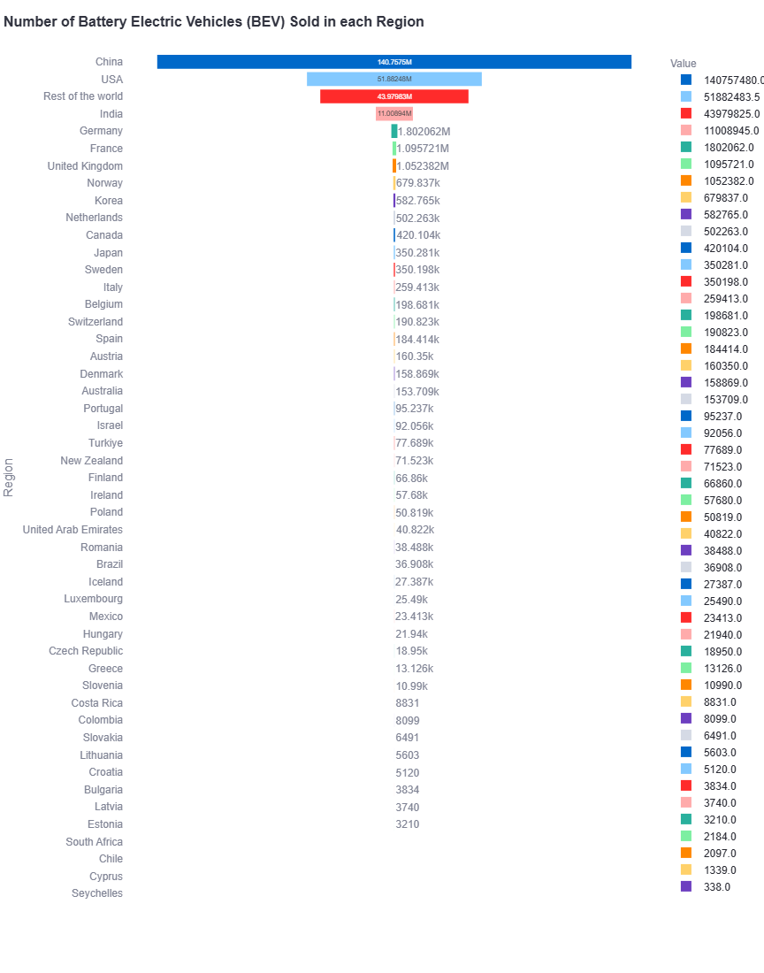

Slide 7
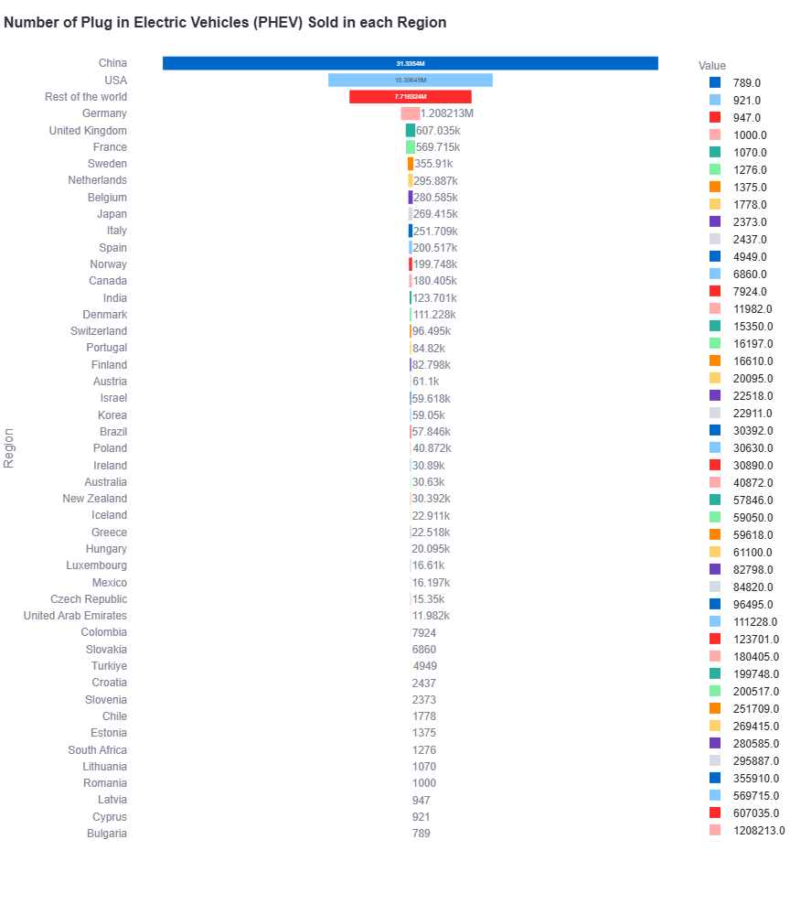

Slide 8
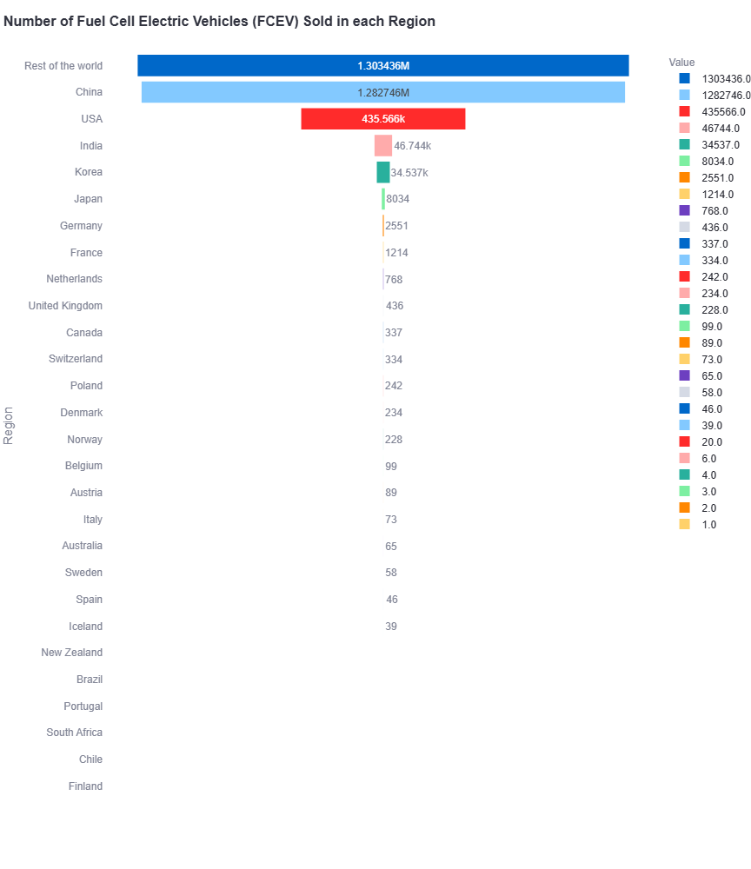

Slide 9
EV Powertrain Sales in From 2011 to 2023

Slide 10
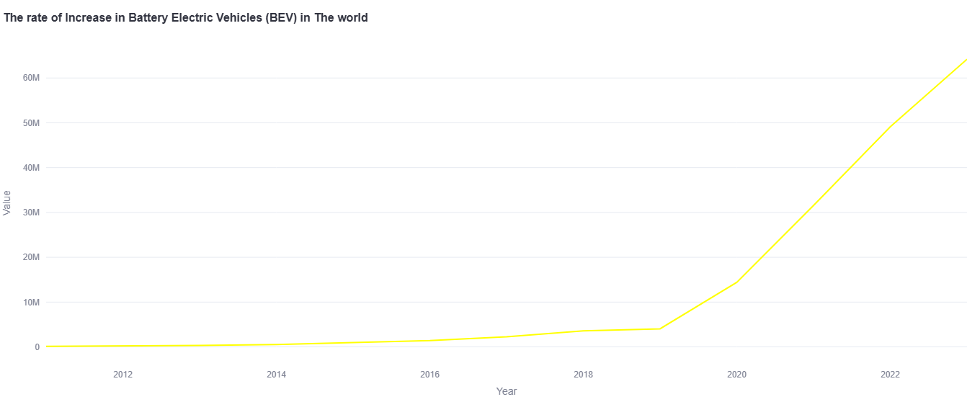

Slide 11
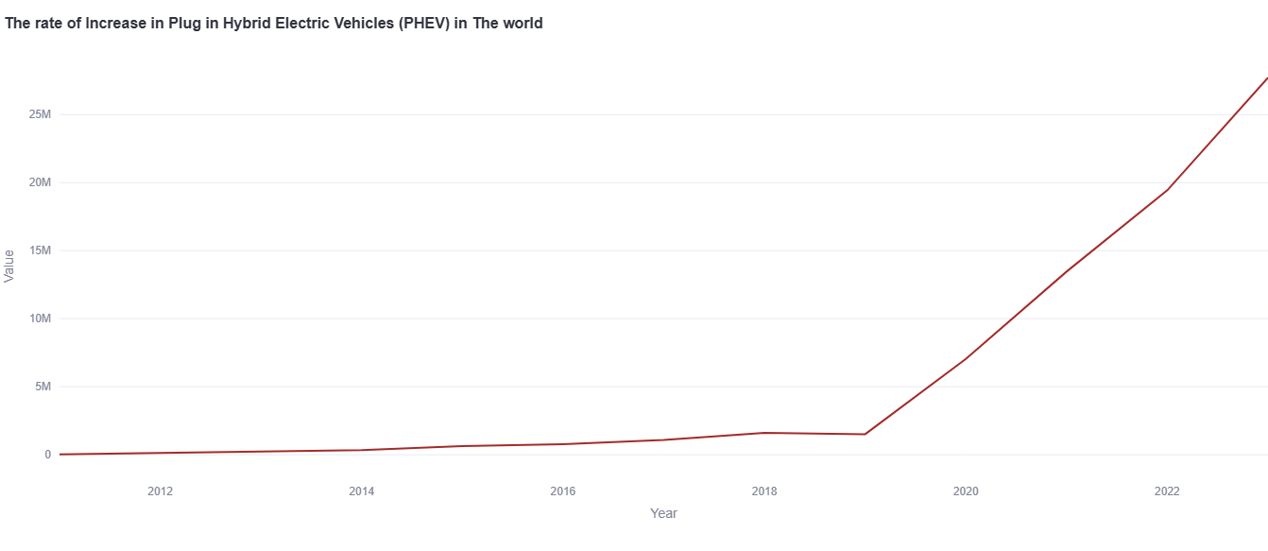

Slide 12
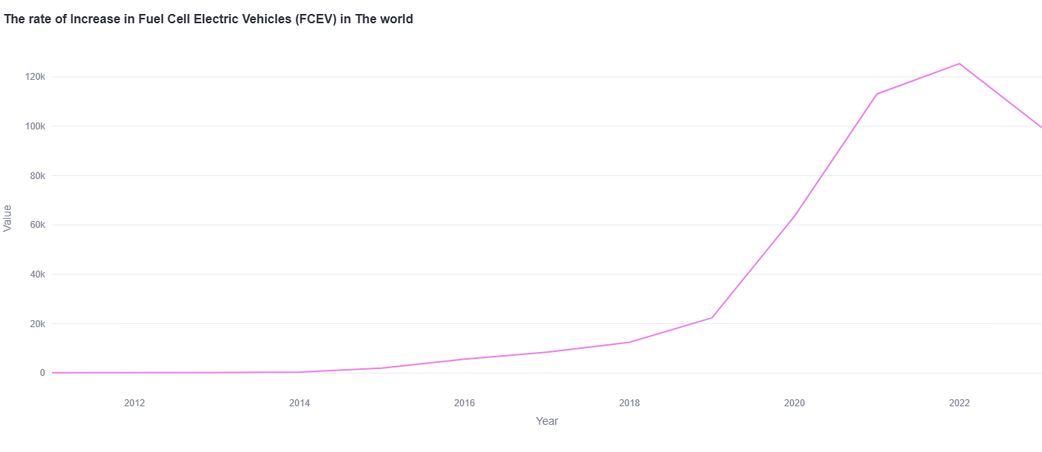

Slide 13
EV Powertrain Percent

Slide 14
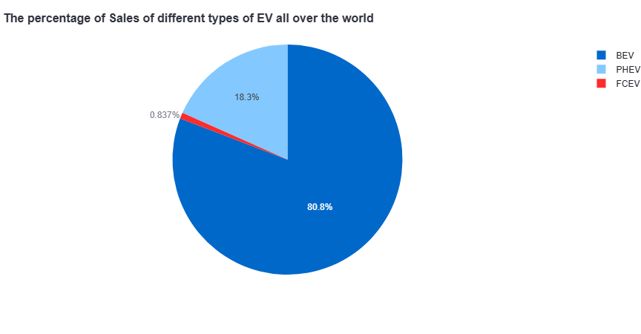

Slide 15
02
EV Chargers Spread in the world

Slide 16
Fast Chargers

Slide 17
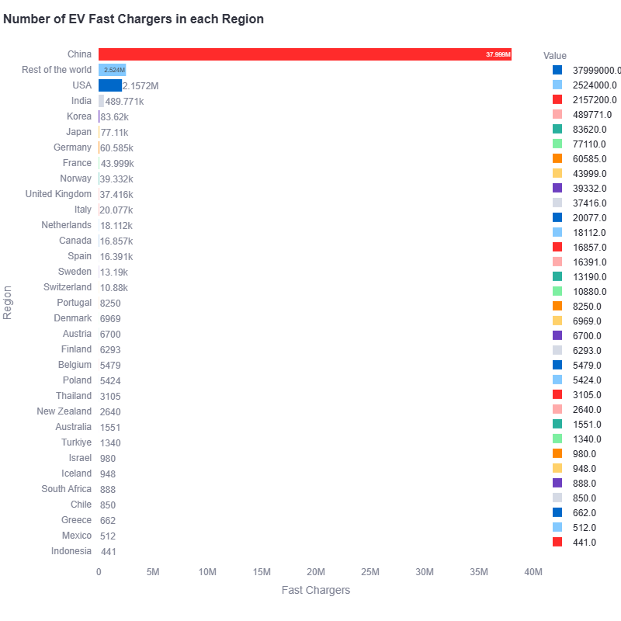

Slide 18
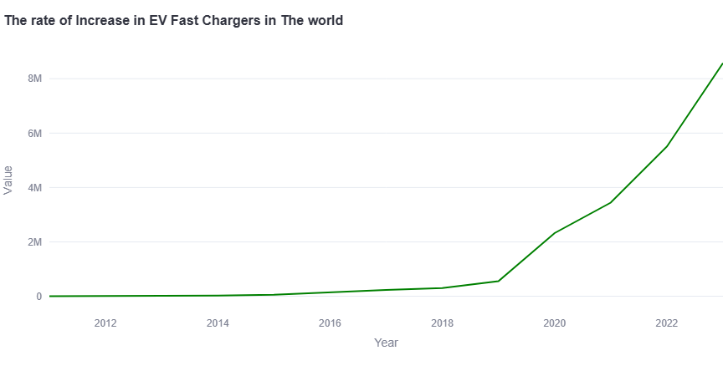

Slide 19
Slow Chargers

Slide 20
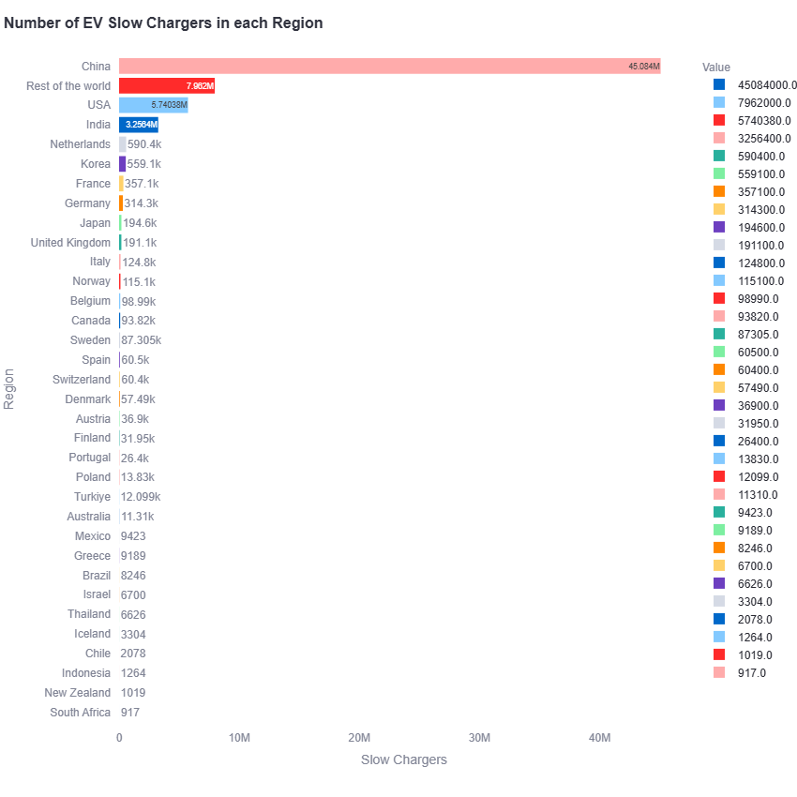

Slide 21
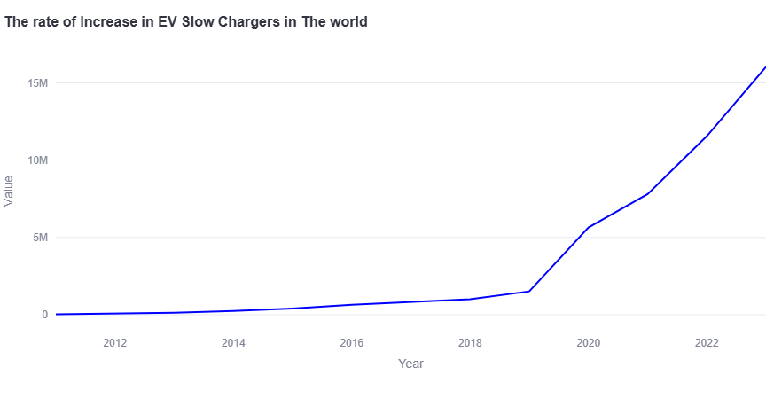

Slide 22
The percentage of Public EV Chargers types Installed

Slide 23
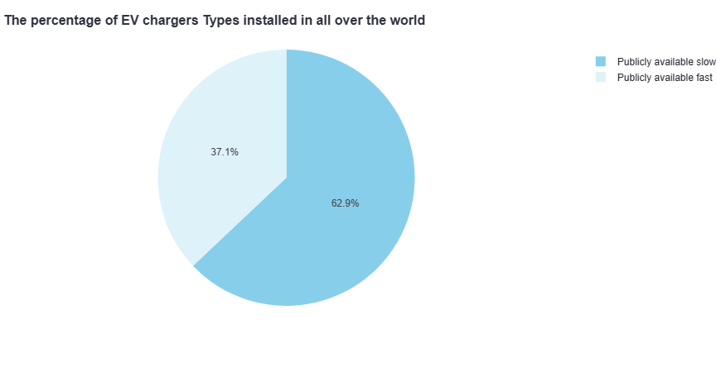

Slide 24
03
EV types Sales in the world

Slide 25
Electric Cars

Slide 26
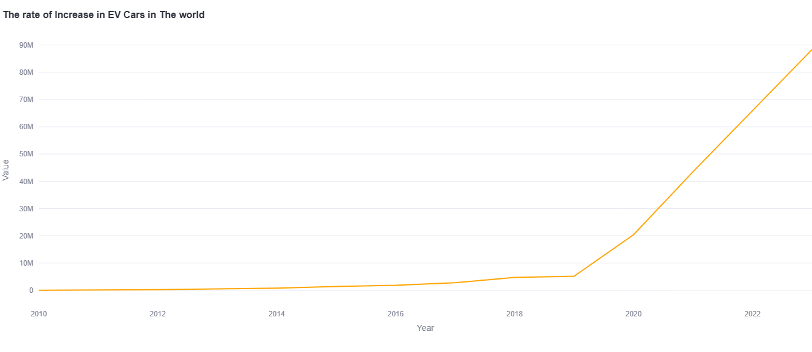

Slide 27
Electric Buses

Slide 28
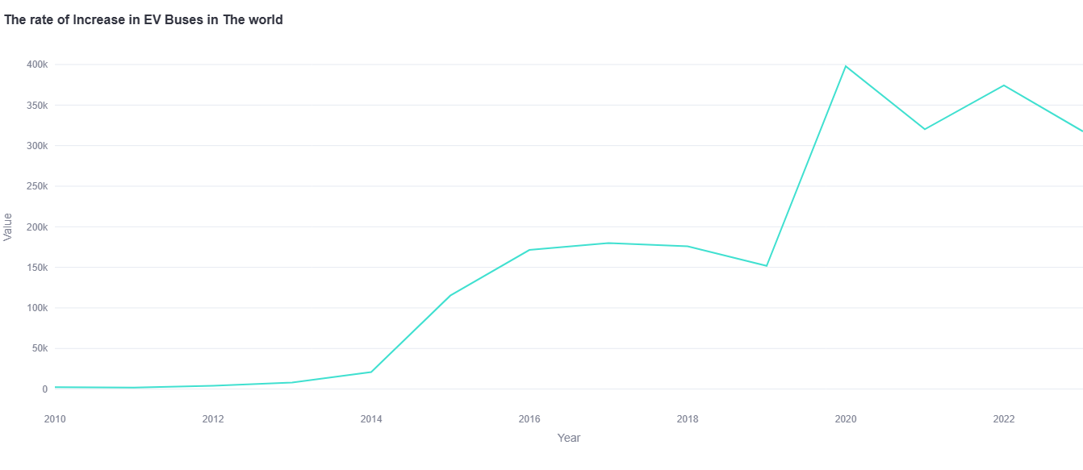

Slide 29
Electric Vans

Slide 30
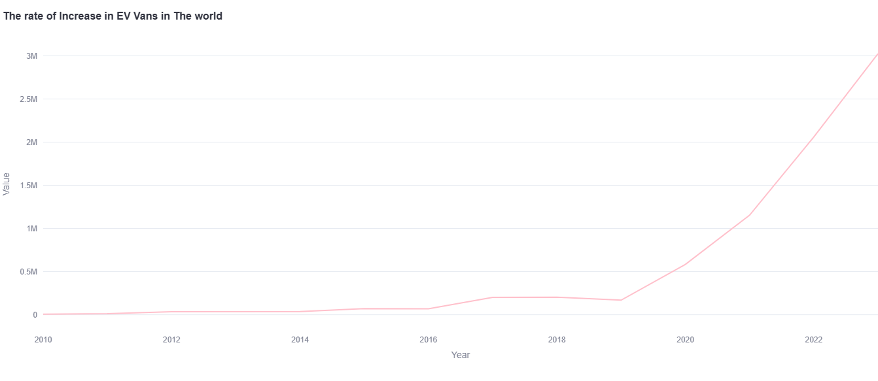

Slide 31
Electric Trucks

Slide 32
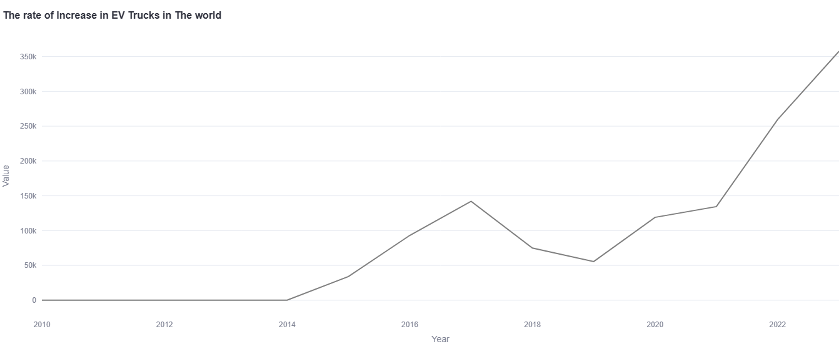

Slide 33
04
Electricity demand in the world

Slide 34
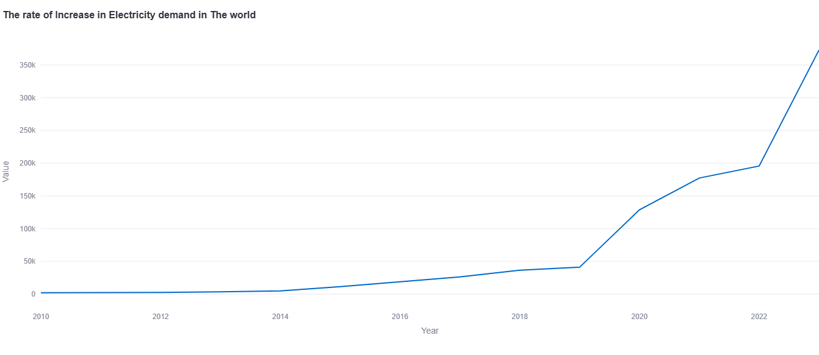

Slide 35
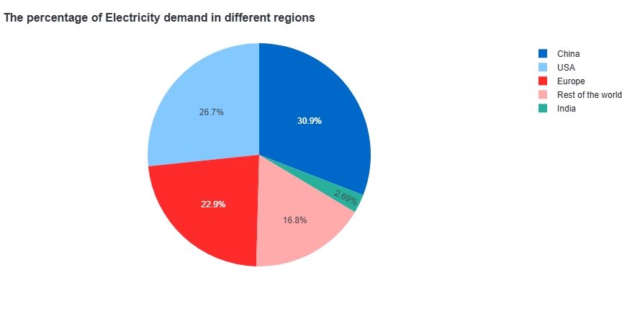

Slide 36
05
EV World Market

Slide 37
EV companies Stock shares from 2010 to 2023

Slide 38
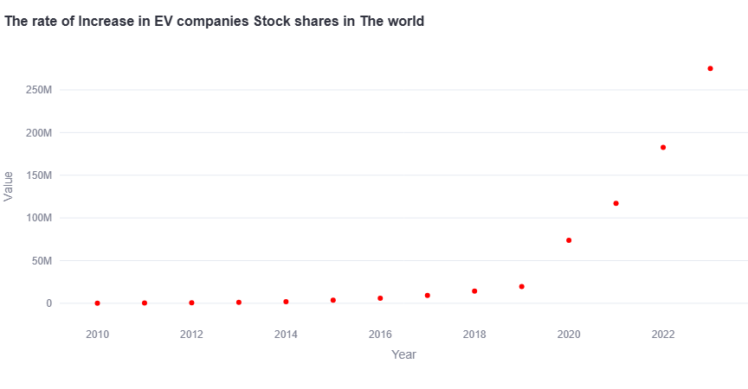

Slide 39
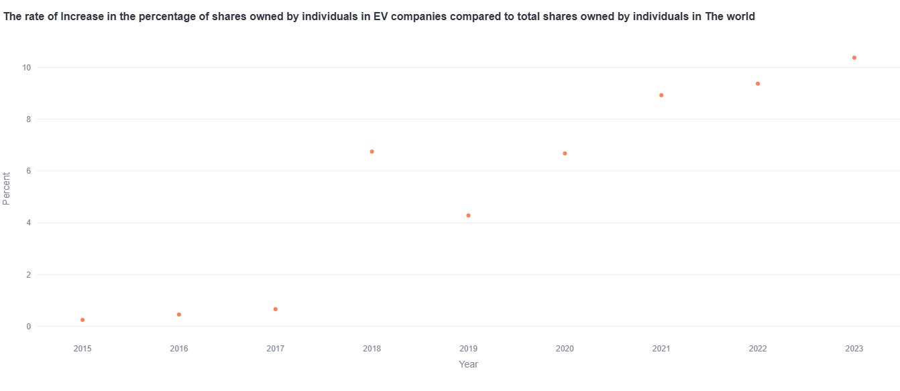

Slide 40
EV Sales percentage compared to total vehicle sales from 2011 to 2023

Slide 41
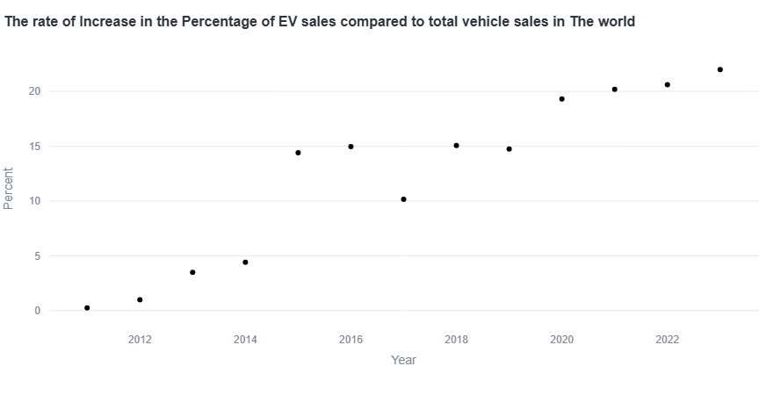

Slide 42
THANKS!
Do you have any questions?

